Slide 1
Leveraging Exploratory Data Analysis for Enhanced Customer Segmentation and Product Recommendations in E-Commerce

Slide 2

Introduction
Online E-commerce is booming and generating vast data.
Companies are increasingly leveraging big data analysis to gain valuable insights into customer behavior and market trends.
Our project centers on the comprehensive analysis of e-commerce shopping data, delving deep into customer purchase patterns.
We aim to uncover hidden patterns, correlations, and trends within the extensive dataset.
By meticulously analyzing data, we will provide actionable insights to enhance product recommendations

Slide 3
Objectives
Performing Exploratory Data Analysis (EDA):
Goal: Understand key aspects of the dataset through statistical evaluation and visual insights.
Approach: Employ descriptive statistics and visualization techniques for pattern recognition.
Outcome: Detailed insights that inform data preparation and modeling strategies.
Customer Segmentation using RFM Analysis:
Goal: Identify distinct customer groups based on purchasing behavior.
Approach: Conduct RFM analysis to segment customers based on their Recency, Frequency, and Monetary value.
Outcome: Clearly defined customer segments for tailored marketing and service approaches.
Product Recommendation System Development:
Goal: Create a personalized shopping experience through product suggestions.
Outcome: A robust recommendation system enhancing customer engagement and potential sales

Slide 4
What questions the project addressed using Big Data??
How can big data platforms help in analyzing and understanding diverse customer behaviors and preferences in the e-commerce sector?
What are the challenges in creating accurate, personalized product recommendations, and how can big data assist in overcoming these?
How can we effectively segment customers based on their purchasing patterns and preferences using big data analysis?
What are the key market trends in e-commerce, and how can we utilize big data to identify and adapt to these trends?
How can big data platforms be leveraged to enhance the user experience on e-commerce platforms, particularly in terms of navigation, product discovery, and overall satisfaction?
How can e-commerce companies utilize big data to make more informed and strategic business decisions?

Slide 5
Data Sources and Collection
The dataset is sourced from a multi category e-commerce platform, contains records of user interactions with products. It includes information on user behavior, such as product views, purchases, and sessions, enabling analysis for customer segmentation and tailored product recommendations.
Format: CSV
The size of the dataset is 5 GB with around 42 Million records.
Dataset: https://www.kaggle.com/datasets/mkechinov/ecommerce-behavior-data-from-multi-category-store?select=2019-Oct.csv

Slide 6




Tools and Technologies
Mongo DB
Python
Jupyter Notebook
Apache Spark
Tableau

Slide 7
Apache Spark:
We selected Apache Spark for its robust capabilities in swiftly processing extensive e-commerce datasets. This choice enables rapid insights and effective management of substantial customer behavior data volumes.
MongoDB:
MongoDB is our preferred database for its user-friendly nature and smooth integration with Apache Spark. Although our current dataset is static, this technology pairing equips us to efficiently manage any future needs for dynamic data handling.
Python:
We utilize Python as our primary programming language due to its extensive selection of data-related libraries. These libraries streamline processes such as data manipulation and analysis, enabling us to concentrate on extracting valuable insights.
Tableau:
Tableau is our chosen tool for data visualization. Its user-friendly design allows for the effortless creation of engaging and informative visual representations, facilitating clear communication of our results to stakeholders with varying levels of technical expertise.

Slide 8
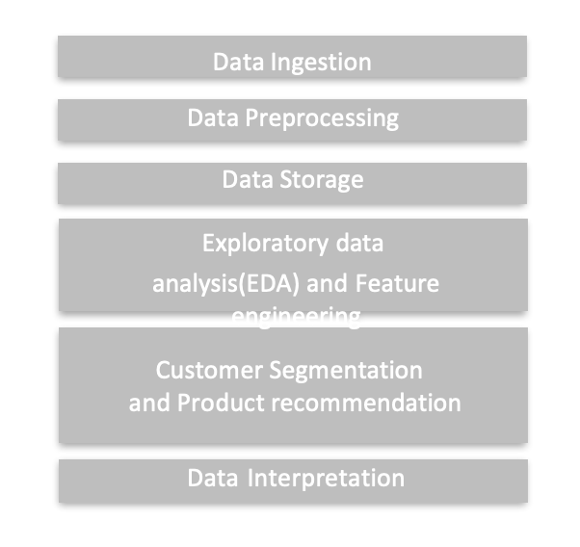
Data Stack Diagram

Slide 9
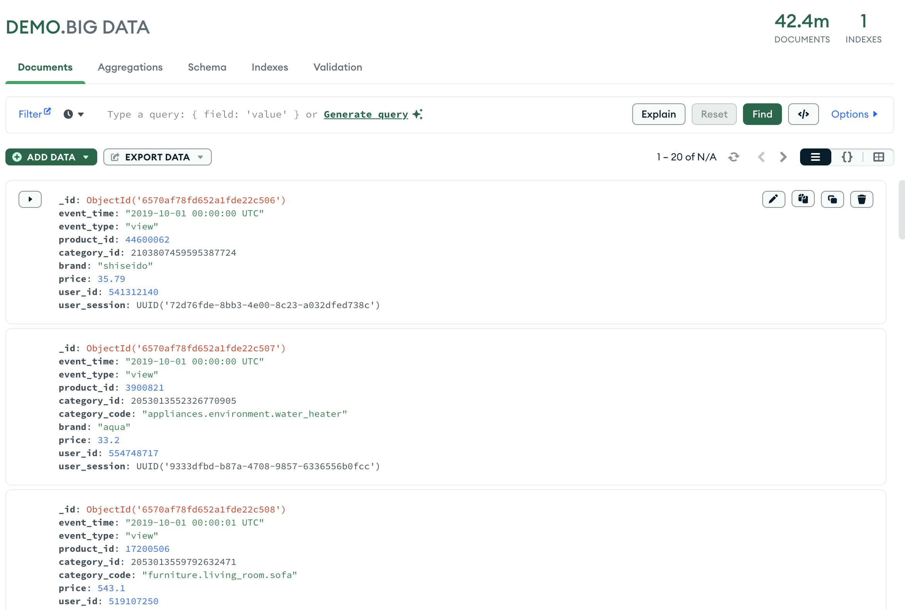
Sample Data in Database

Slide 10
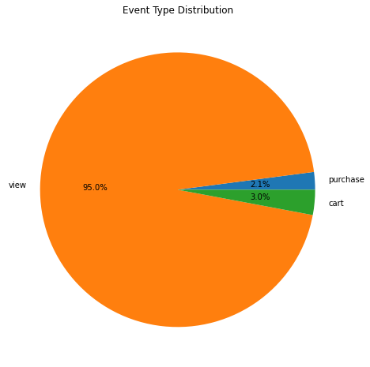
Reports, Insights, and Recommendations
Event Type Distribution:
Predominant user interactions are views, with purchases forming a small fraction.
Recommendation: Focus on conversion rate optimization to turn views into sales.

Slide 11
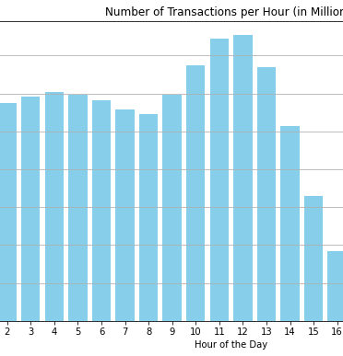
Number of Transactions per Hour
Peak transaction hours are midday, showing customer activity patterns.
Recommendation: Allocate more resources to server bandwidth and customer service during these peak times.

Slide 12
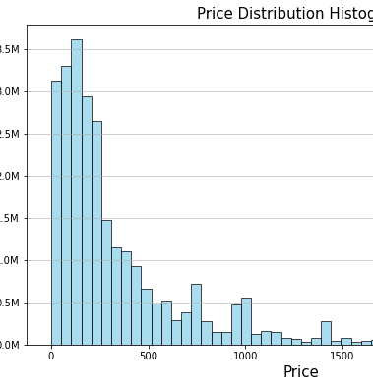
Price Distribution Histogram:
Most products fall within the lower price range, suggesting a budget-conscious customer base.
Recommendation: Consider promoting higher-end products to increase average order value.

Slide 13
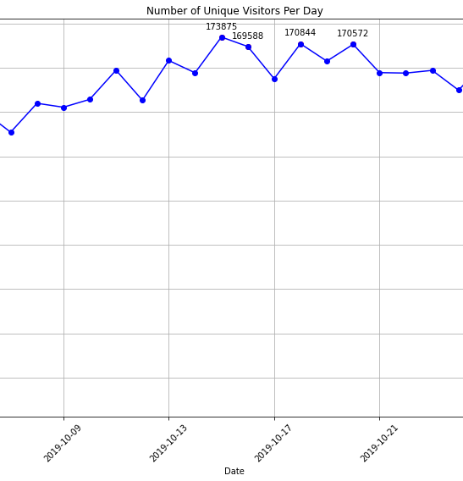
Number of Unique Visitors Per Day:
Visitor numbers are relatively stable, with occasional spikes.
Recommendation: Investigate causes of spikes for targeted marketing campaigns.

Slide 14
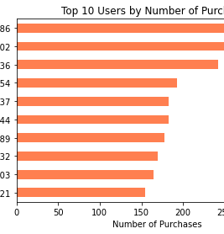
Top 10 Users by Number of Purchases
A small group of users contributes to a significant portion of purchases.
Recommendation: Develop loyalty programs to reward these top buyers and encourage more frequent purchases

Slide 15
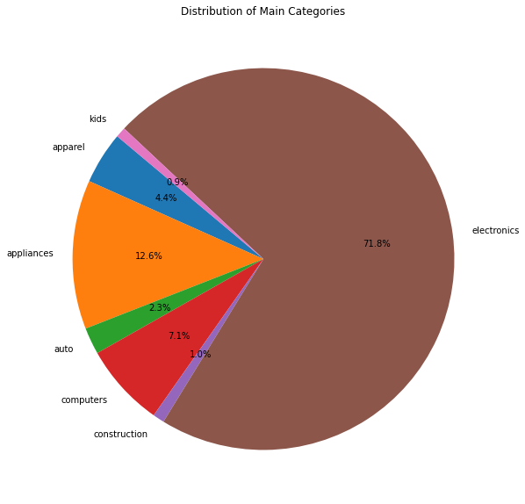
Distribution of Main Categories:
Electronics dominate the sales, indicating customer interest and market demand.
Recommendation: Expand inventory in electronics to capture more market share.

Slide 16
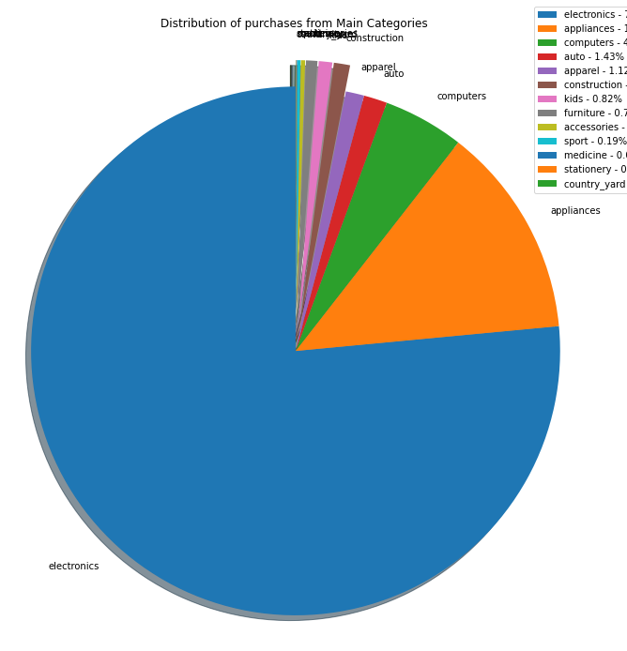
Distribution of Purchases from Main Categories
Electronics also lead in purchase distribution, confirming their sales dominance.
Recommendation: Explore upselling opportunities within the electronics category to increase sales.

Slide 17
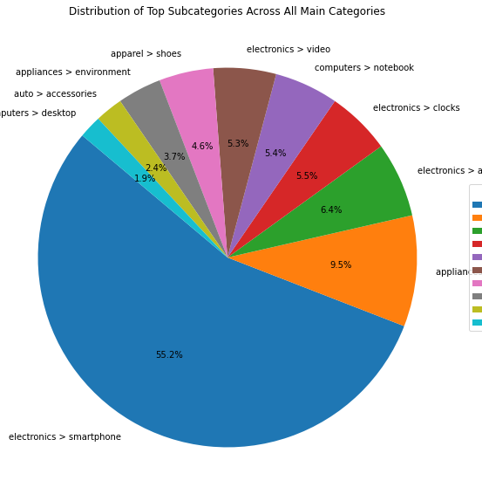
Subcategory Distribution Across All Main Categories
Smartphones and audio devices are the most popular subcategories.
Recommendation: Partner with smartphone and audio device brands for exclusive deals to drive traffic and sales.

Slide 18
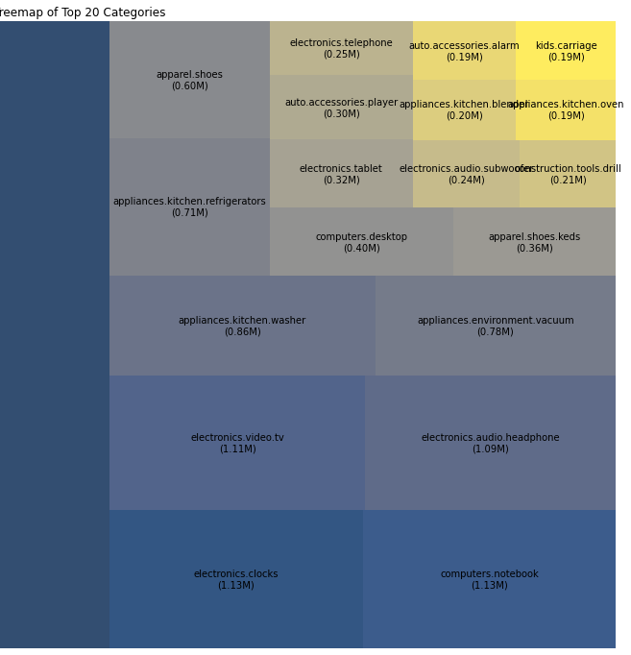
Treemap of Top 20 Categories
Certain subcategories within electronics and appliances show high transaction counts.
Recommendation: Enhance marketing efforts in these high-performing subcategories.

Slide 19
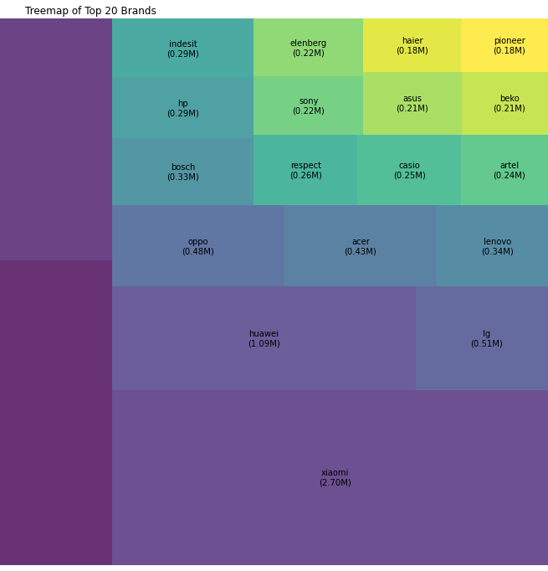
Treemap of Top 20 Brands:
Dominance of brands like Samsung and Apple in transactions.
Recommend strategic partnerships with top brands to capitalize on their market appeal.

Slide 20
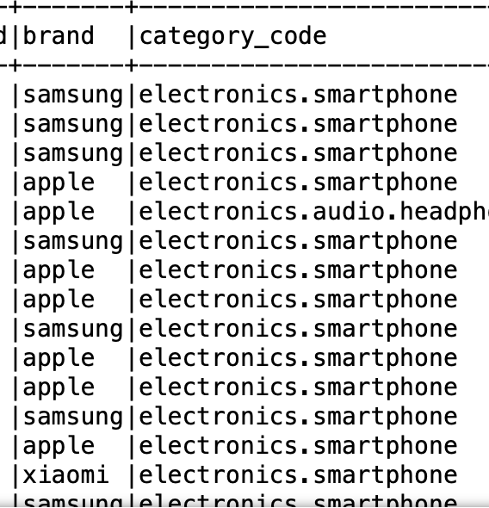
Top Products by Purchase Count:
Samsung and Apple smartphones lead in sales, indicating strong brand loyalty.
Advise increased marketing for top-selling smartphones and related accessories for better cross-selling.

Slide 21
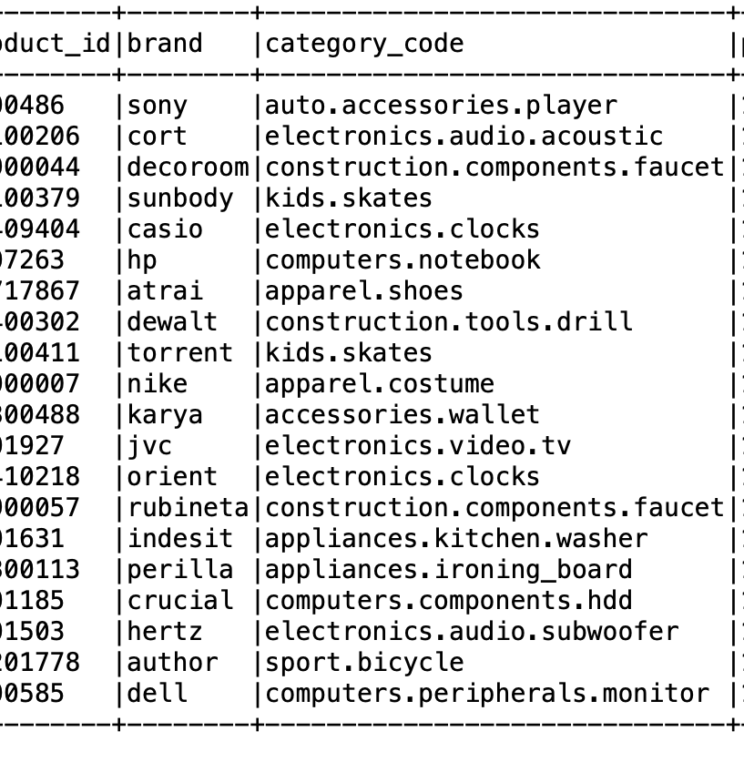
Products with least Purchase Counts:
A diverse range of products have single purchases, from electronics to apparel.
Suggest a review of long-tail inventory to optimize stock levels and minimize holding costs.

Slide 22
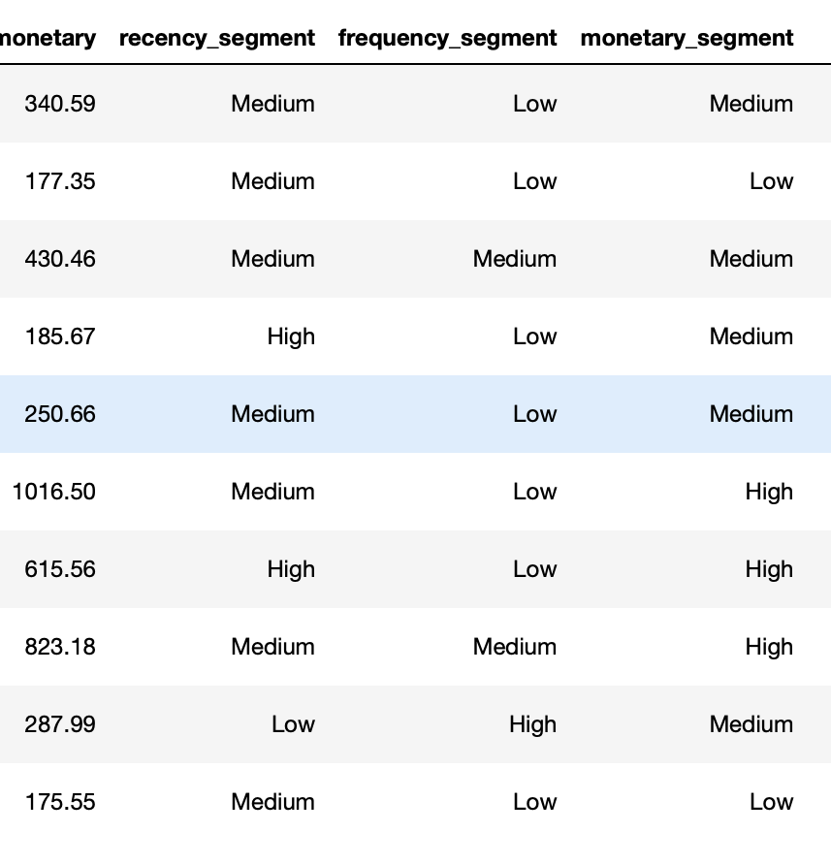
Customer Segmentation
Valued Customer: Assigned to those with high monetary value from purchases.
Loyal Customer: For those with frequent purchases yet not classified as 'Valued’.
New Customer: Recent shoppers who are neither 'Valued' nor 'Loyal'.
Lost Customer: Individuals with high recency, indicating a lapse in engagement.
Regular Customer: Customers who don't specifically fit into the above categories.

Slide 23
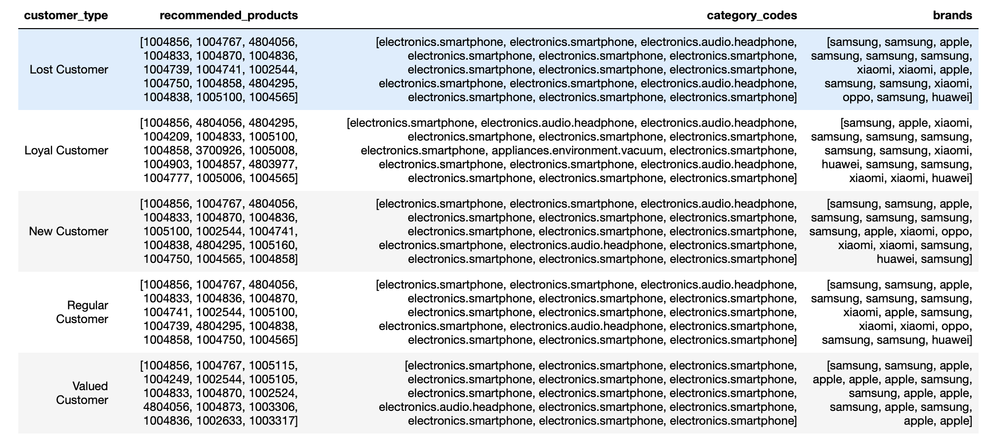
Product Recommendation System
Notes:
What specific problems or questions the project addressed using big data platforms?
MAKE SURE TO EXPLAIN

Slide 24
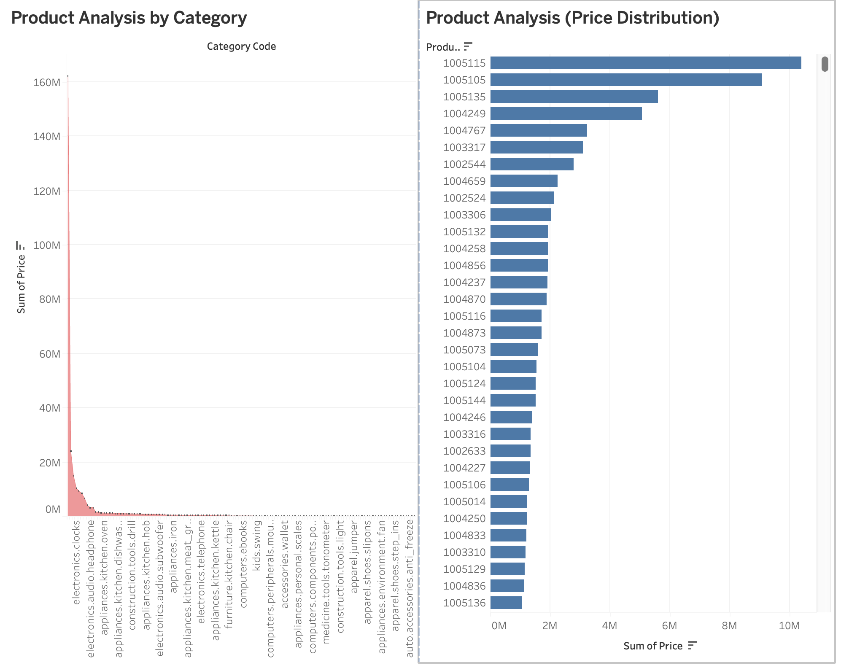
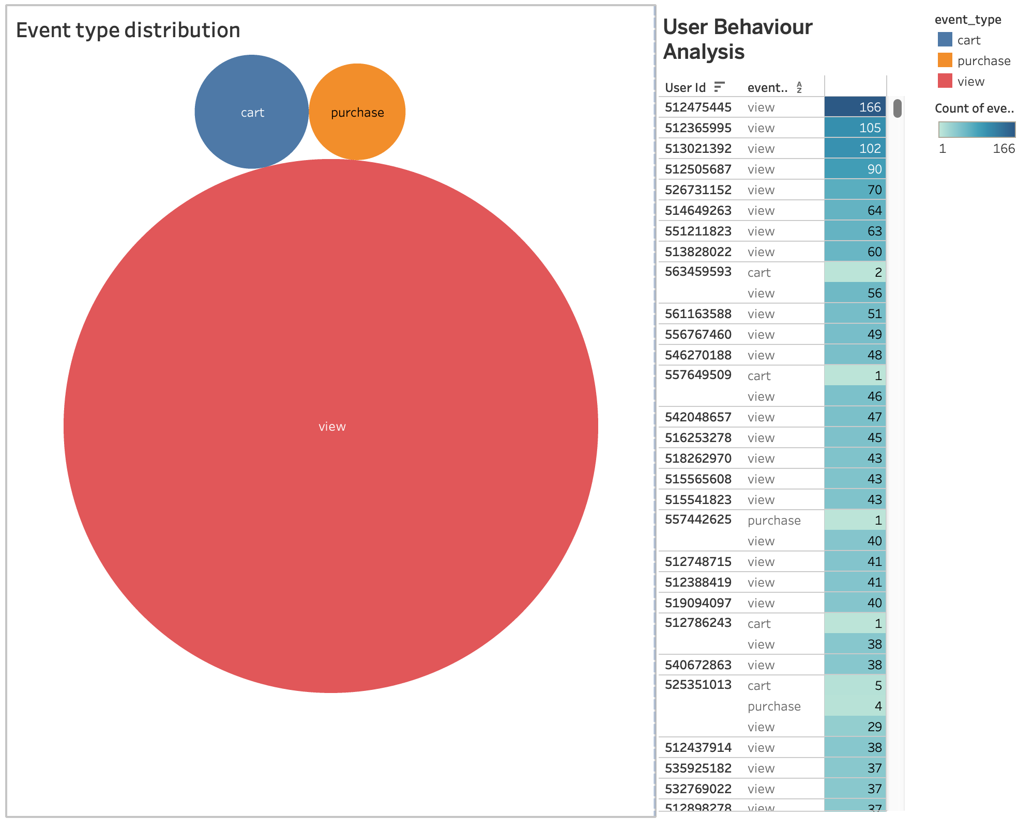
Tableau Visualizations

Slide 25
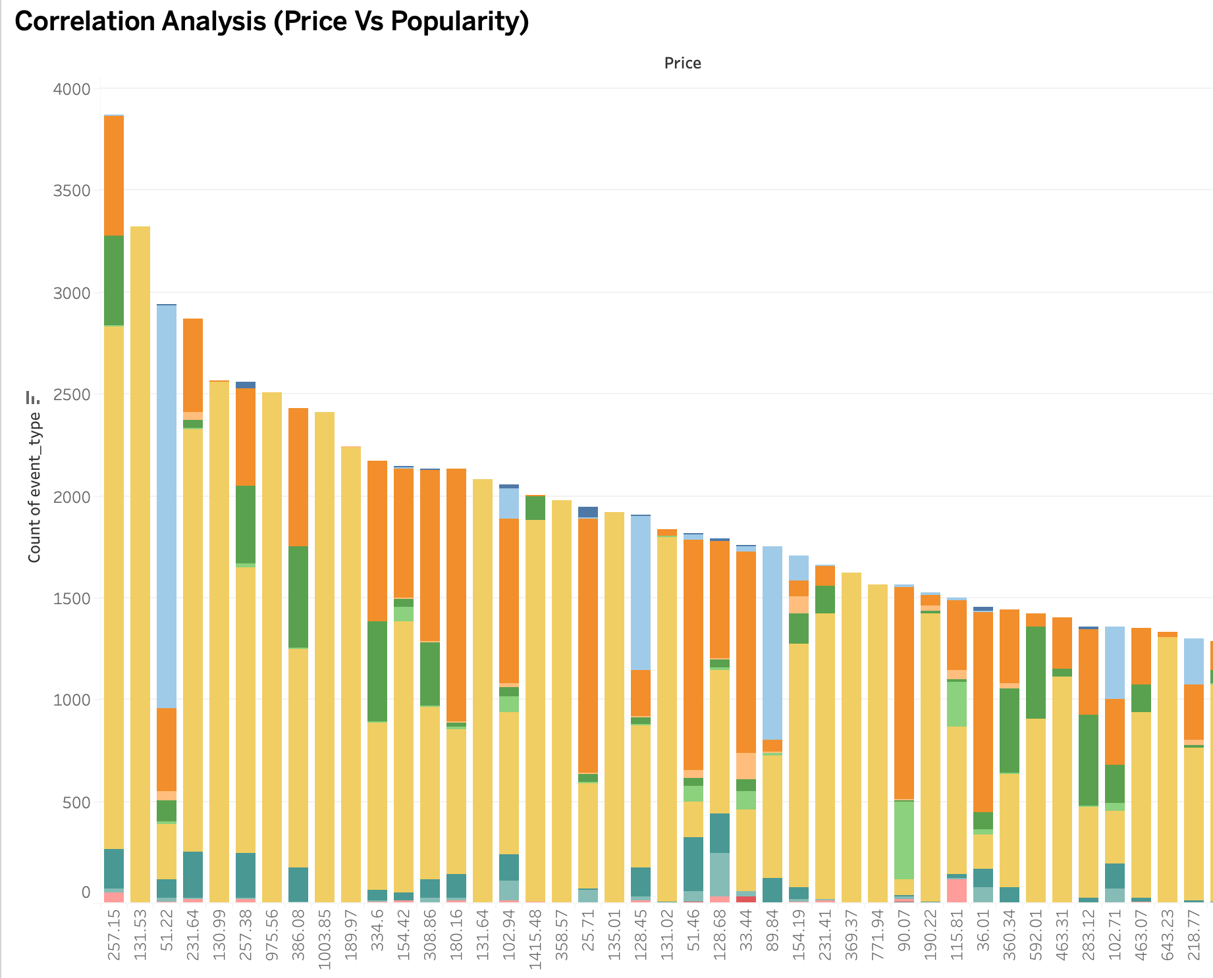
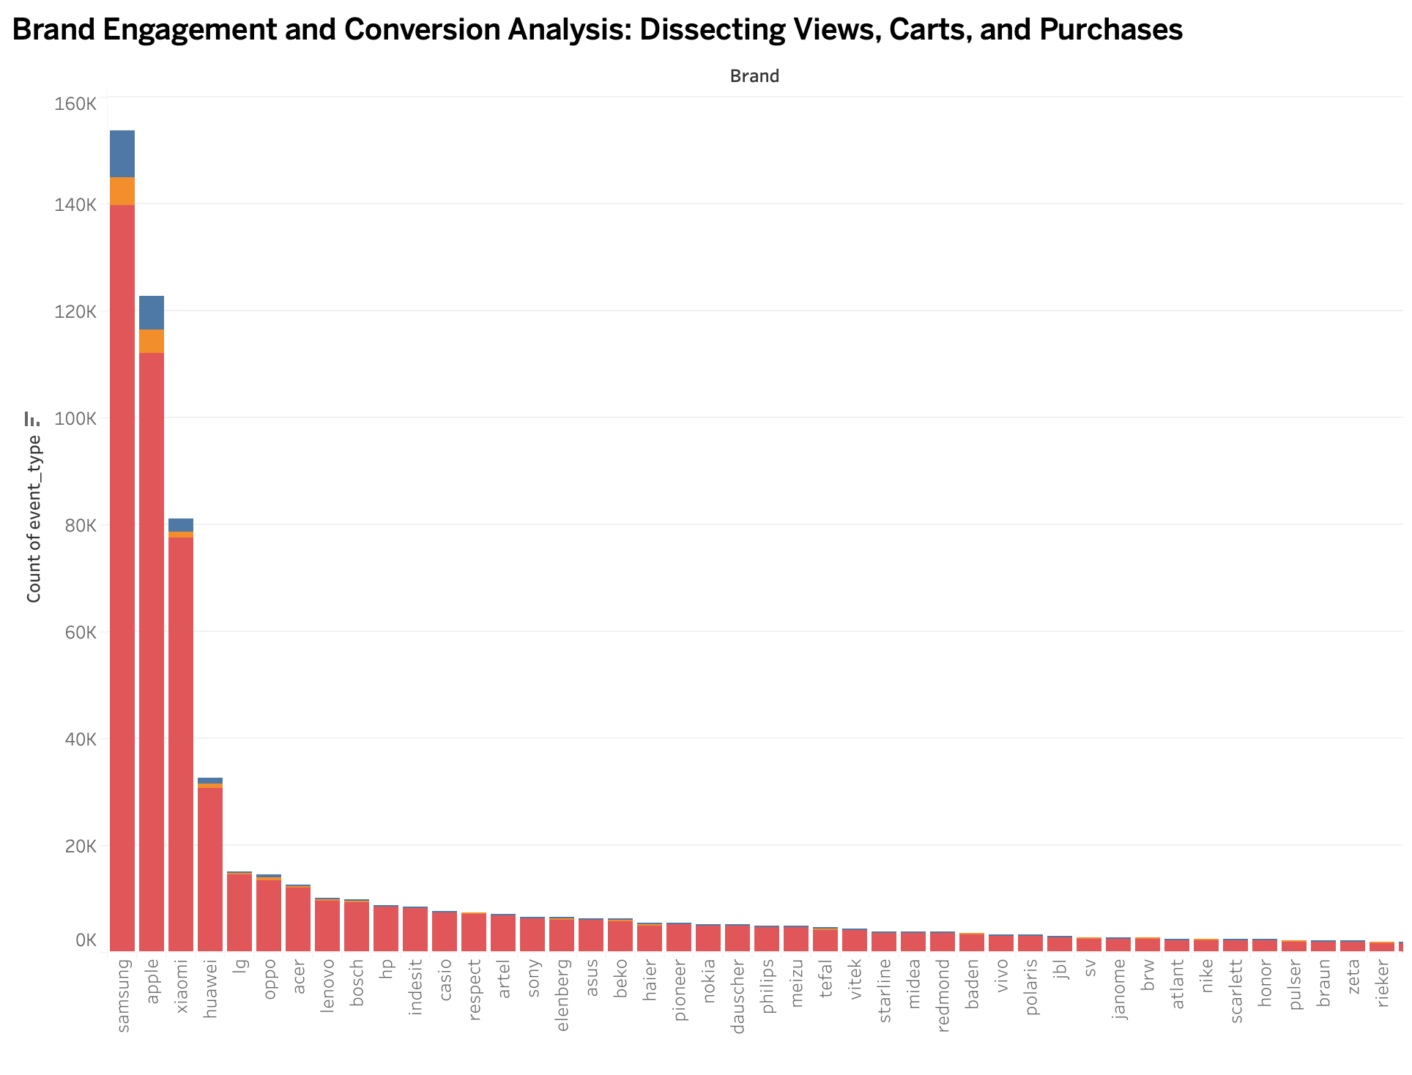
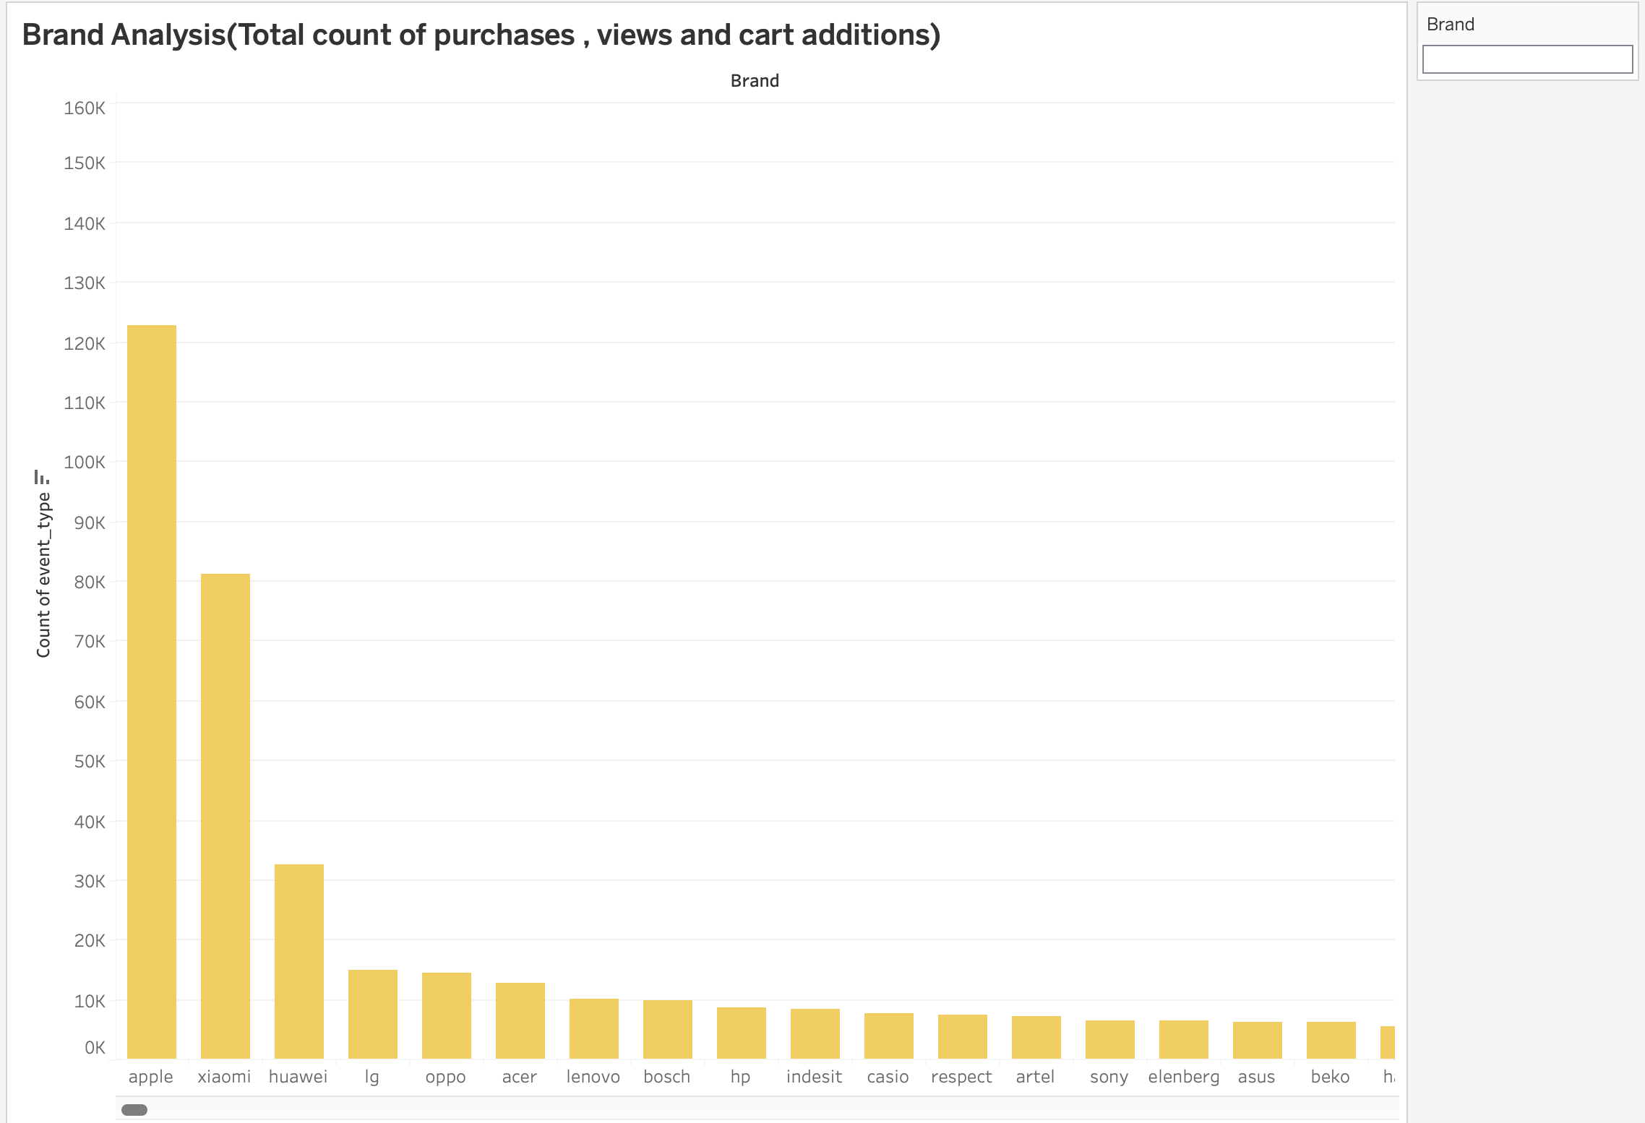

Slide 26
Challenges
Handling and processing large-scale e-commerce data
Data Sparsity and Missing Values: The dataset primarily consists of user interactions without explicit ratings or preferences, leading to sparse data. Additionally, key columns like 'category_code' and 'brand' have missing values, which can hinder the accuracy of recommendation systems.
Limited Behavioral Insights and Categorical Features: The dataset may lack in-depth user behavioral data, such as session duration or page interaction details, limiting insight depth. Furthermore, non-numeric features like 'event_type' and 'category_code' need to be preprocessed for effective use in predictive models.
Feature Selection and Engineering
Scalability and Performance (Ensuring that the segmentation and recommendation system can handle large datasets efficiently.)

Slide 27
Conclusion
The project effectively used exploratory data analysis (EDA) to analyze large e-commerce datasets, uncovering vital customer behavior patterns and trends. This emphasized the role of EDA in turning raw data into valuable insights.
Through RFM analysis, the project successfully segmented customers based on their buying patterns. This led to more personalized marketing strategies, thereby boosting customer engagement and satisfaction, and highlighted the importance of customizing approaches in e-commerce.
Utilizing Apache Spark, the project developed a sophisticated product recommendation system that tailored suggestions to various customer segments, enhancing user experience and indicating potential for higher sales and loyalty. This illustrated the significant impact of big data analytics in e-commerce.
Future enhancements for this project could focus on embracing real-time data processing, leveraging sophisticated AI techniques, and harnessing multi-channel and sentiment data, all while prioritizing user experience and ethical considerations, to significantly refine and expand the scope of e-commerce personalization and global market engagement.

Slide 28
References
Kaggle. (n.d.). E-commerce behavior data from a multi-category store [Data set]. Retrieved [Today's Date], from https://www.kaggle.com/datasets/mkechinov/ecommerce-behavior-data-from-multi-category-store?select=2019-Oct.csv
A. Katal, M. Wazid and R. H. Goudar, "Big data: Issues, challenges, tools and Good practices," 2013 Sixth International Conference on Contemporary Computing (IC3), Noida, India, 2013, pp. 404-409, doi: 10.1109/IC3.2013.6612229.
Akter, S., Wamba, S.F. Big data analytics in E-commerce: a systematic review and agenda for future research. Electron Markets 26, 173–194 (2016). https://doi.org/10.1007/s12525-016-0219-0

Slide 29
THANK YOU!

